Slide 1









Slide 2
Good Morning!
Thank you for joining us to discuss all things ADHD
The aim of today is to share resources and just chat to other parents and staff about their experience. It is great to get advice and ideas from others to continue to support some of our neurodivergent pupils at home and in school.

Slide 3
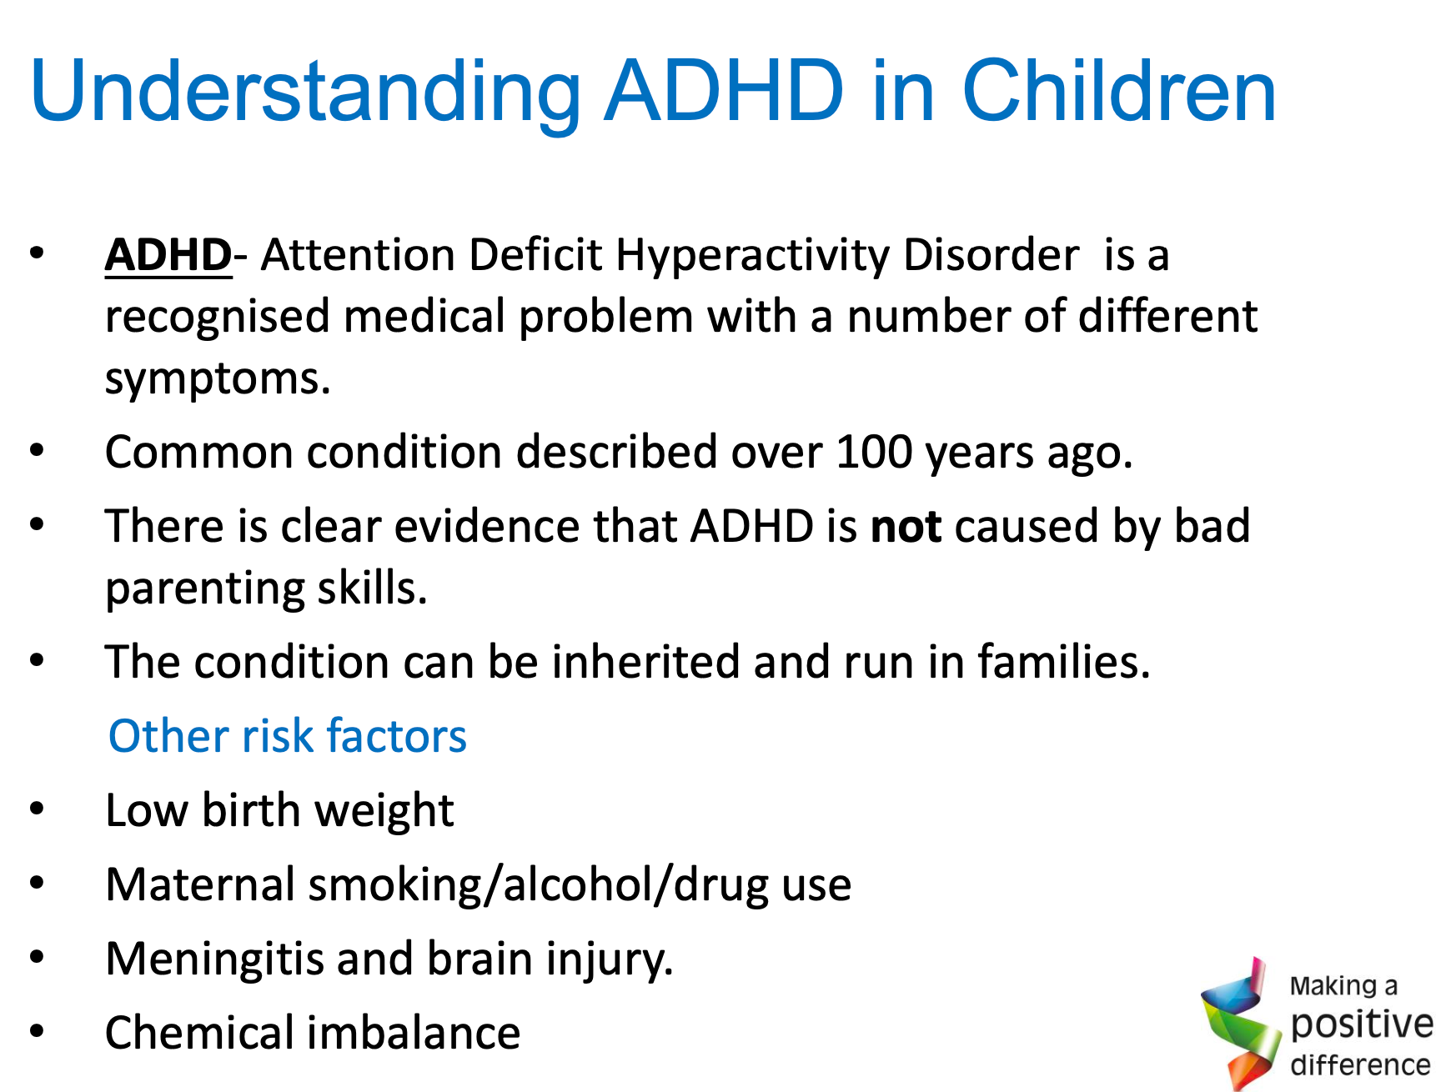

Slide 4
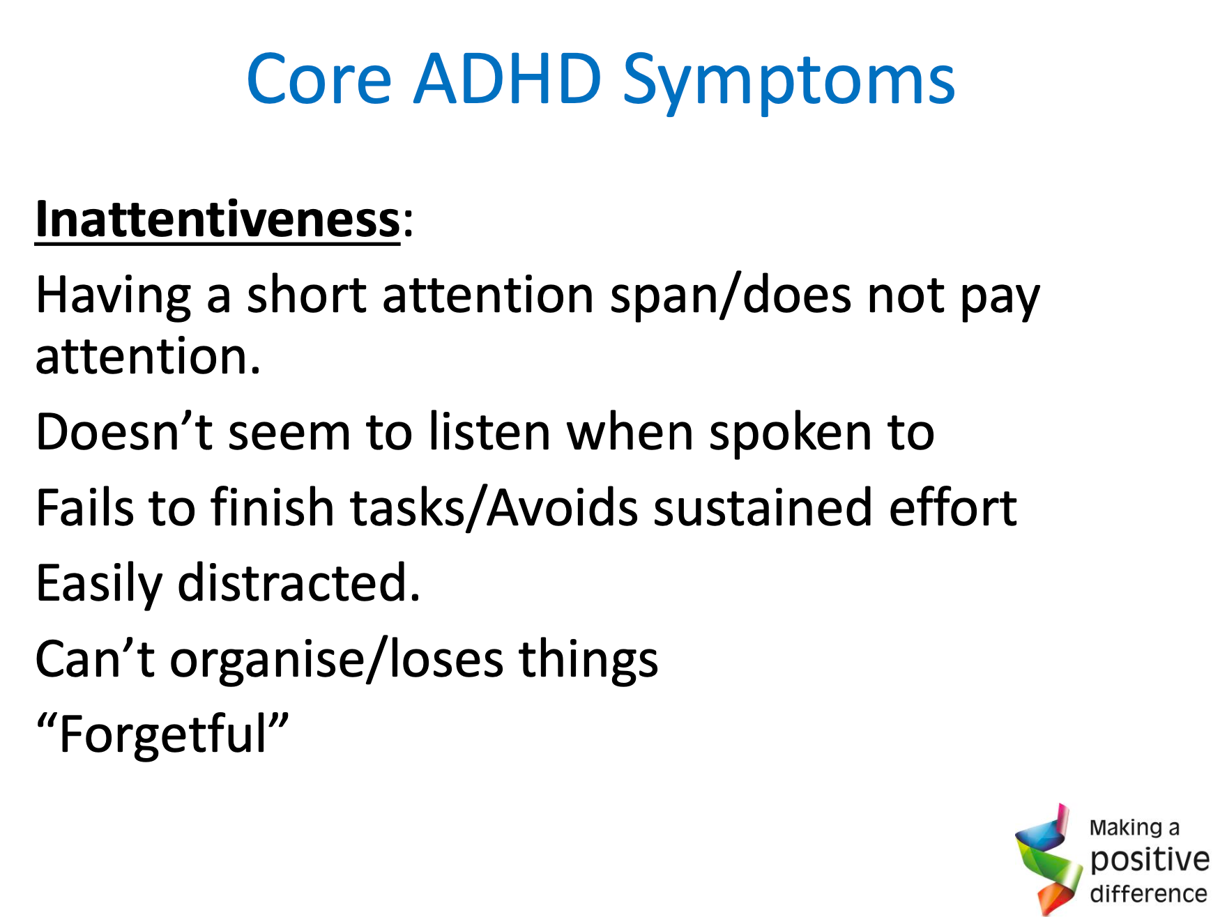
Activities
Subject
Learning Objectives

Slide 5
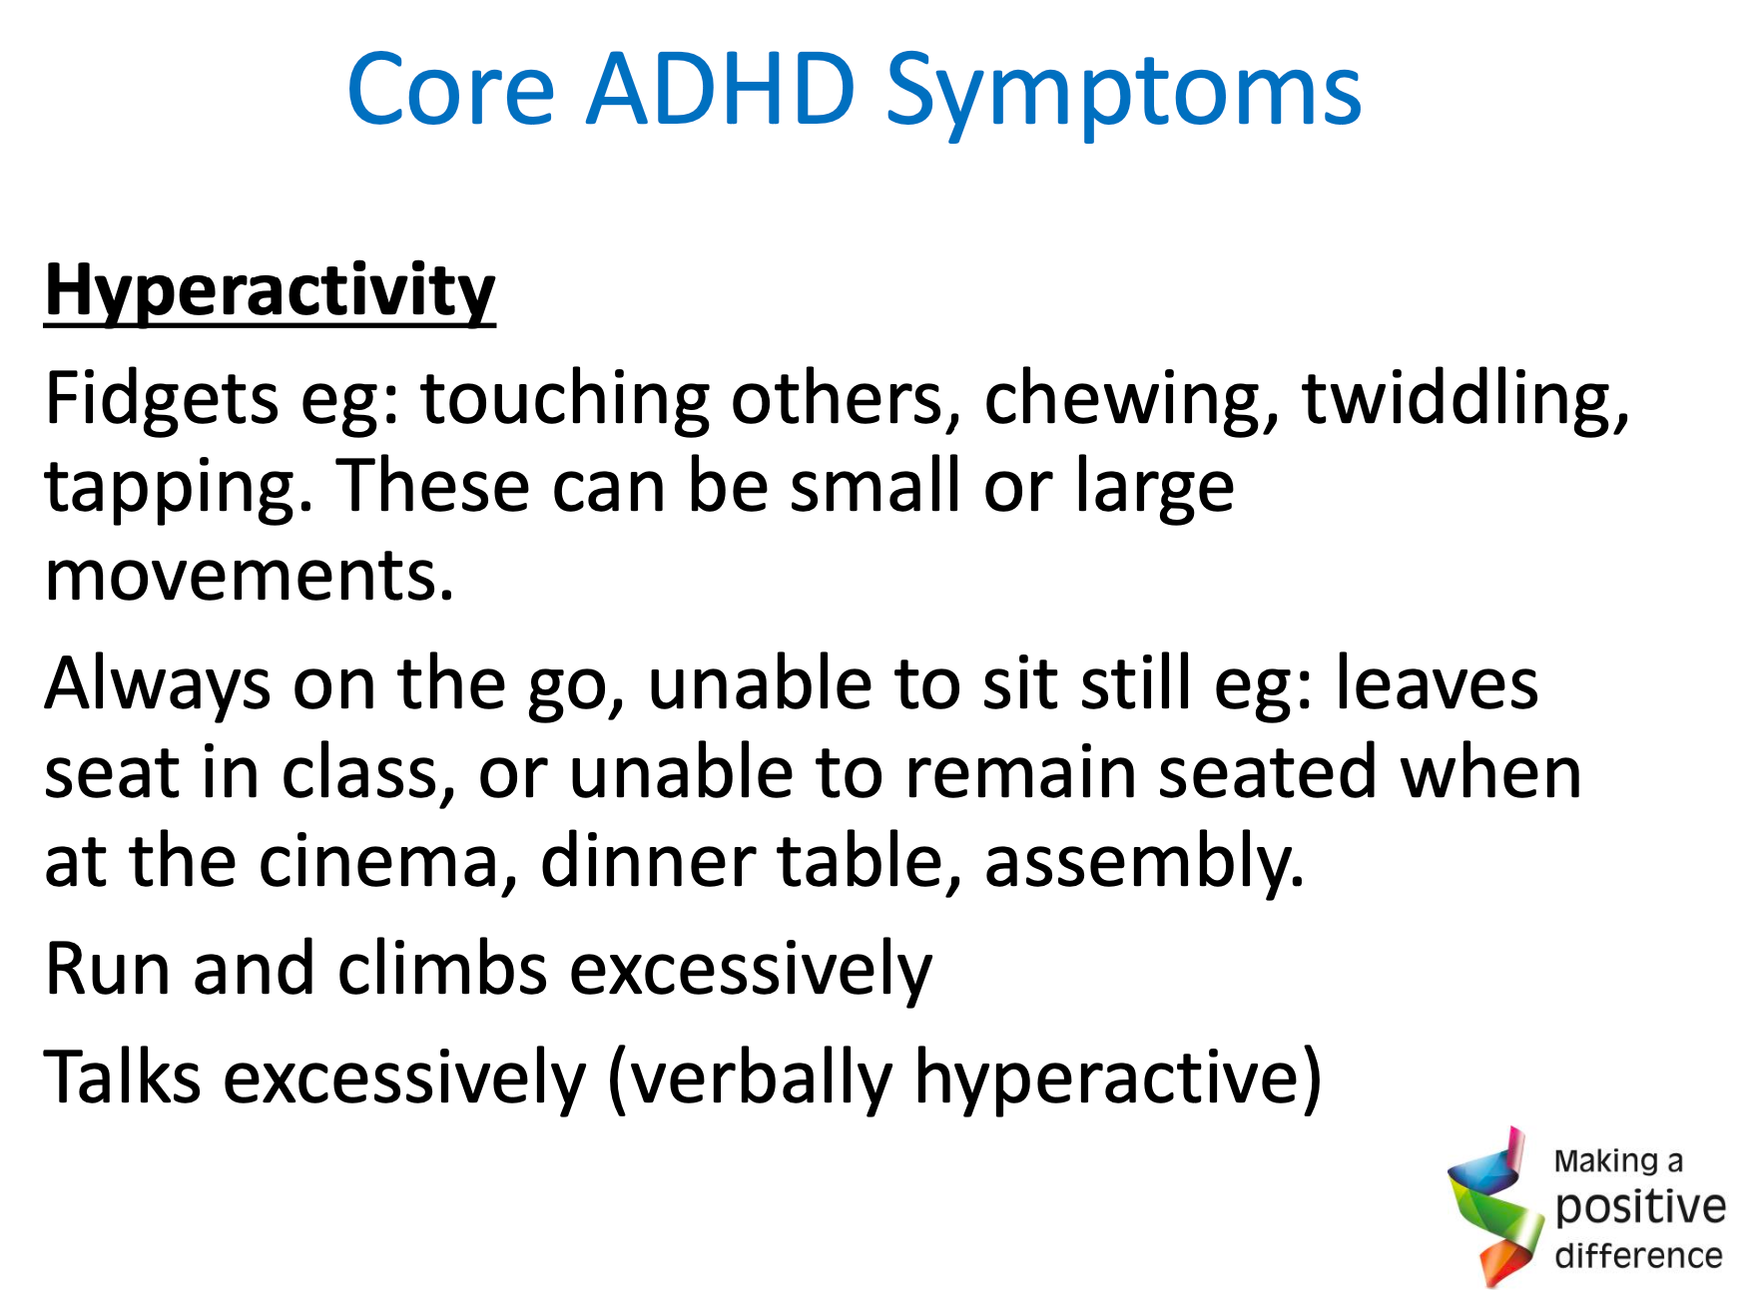

Slide 6
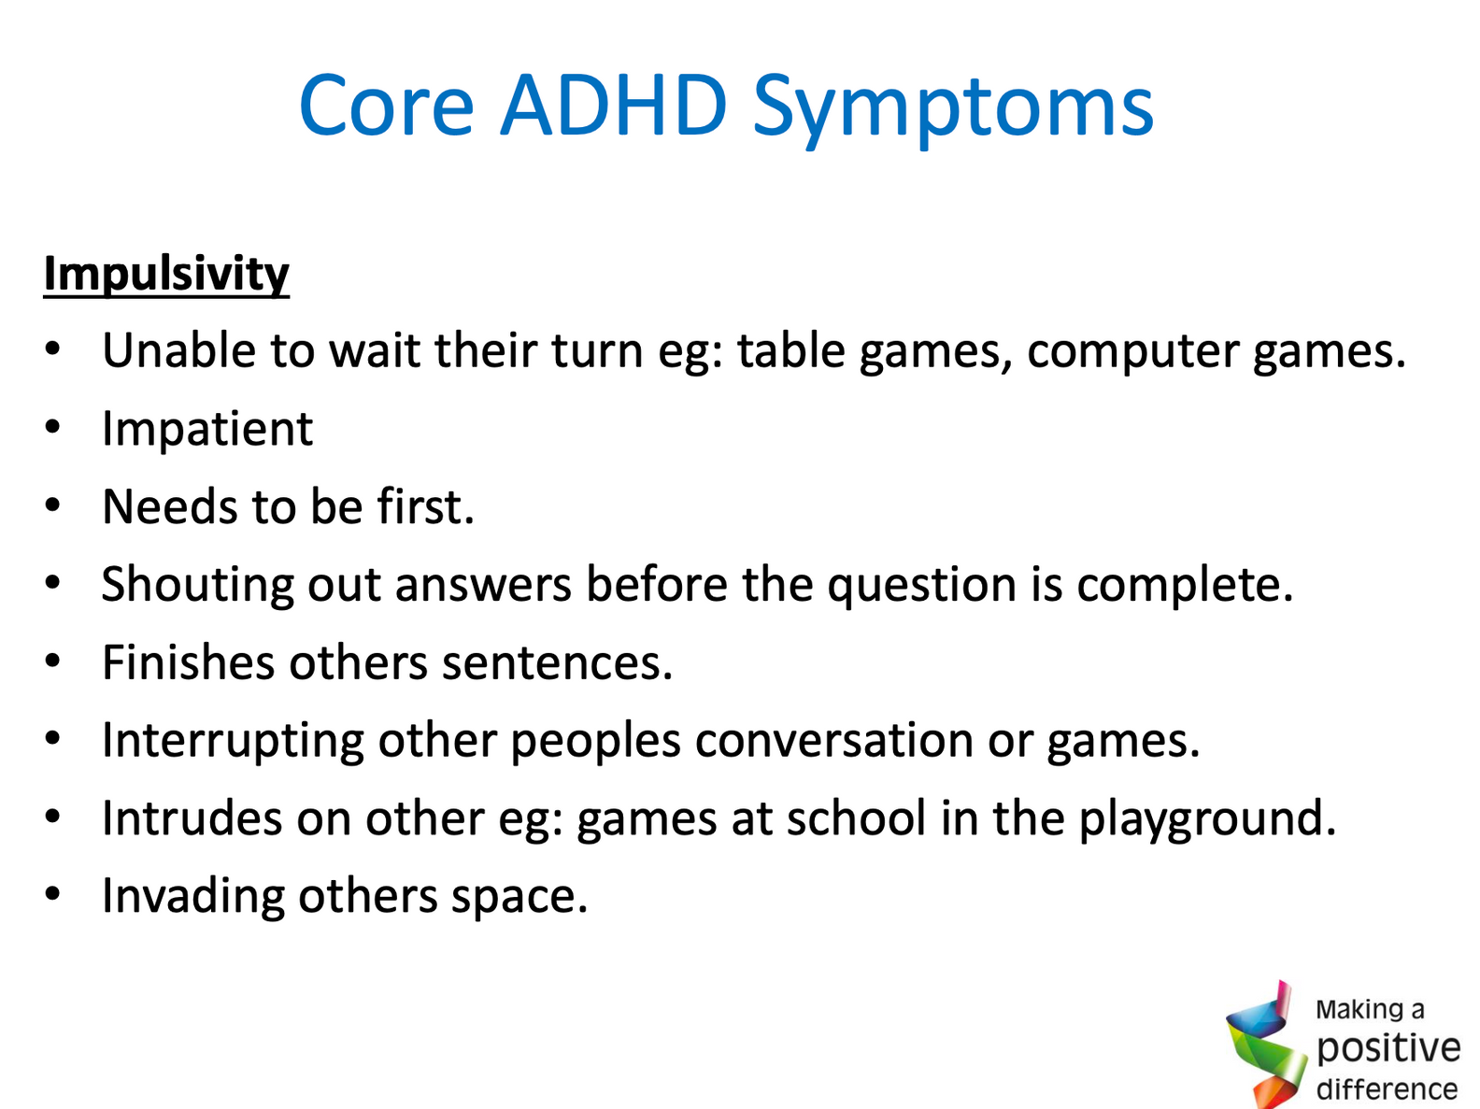

Slide 7
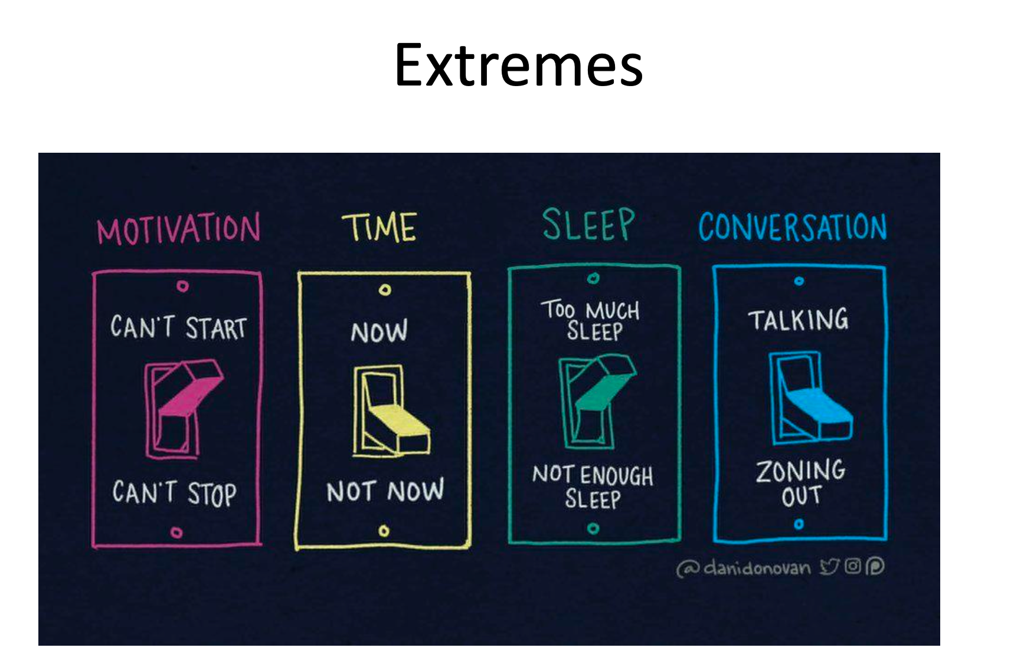

Slide 8
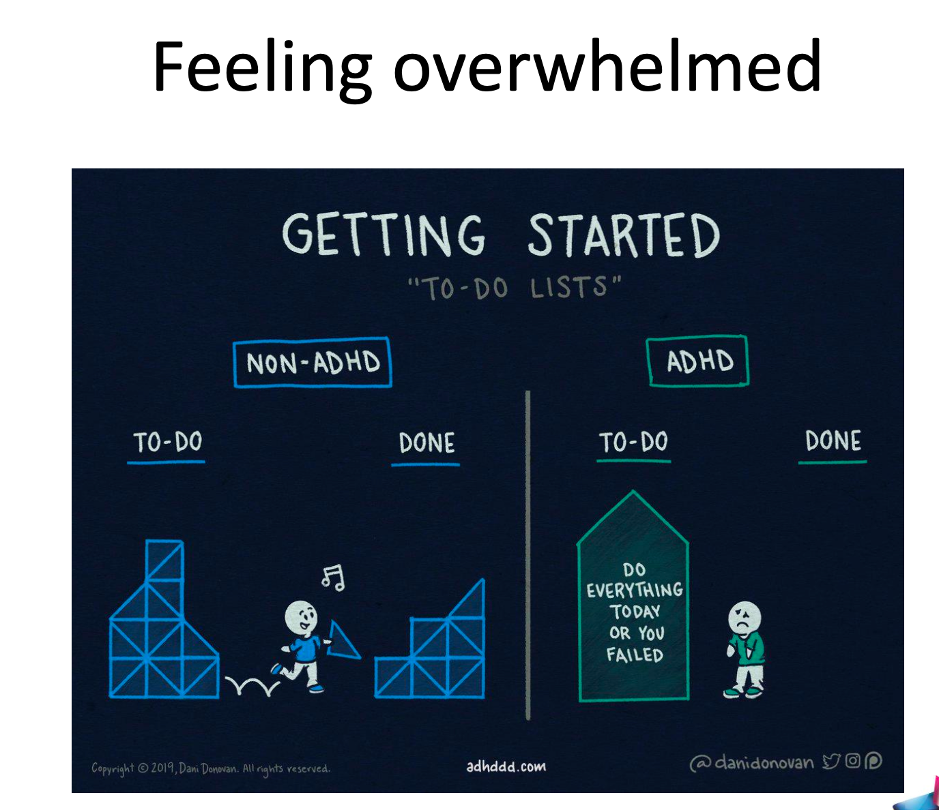

Slide 9
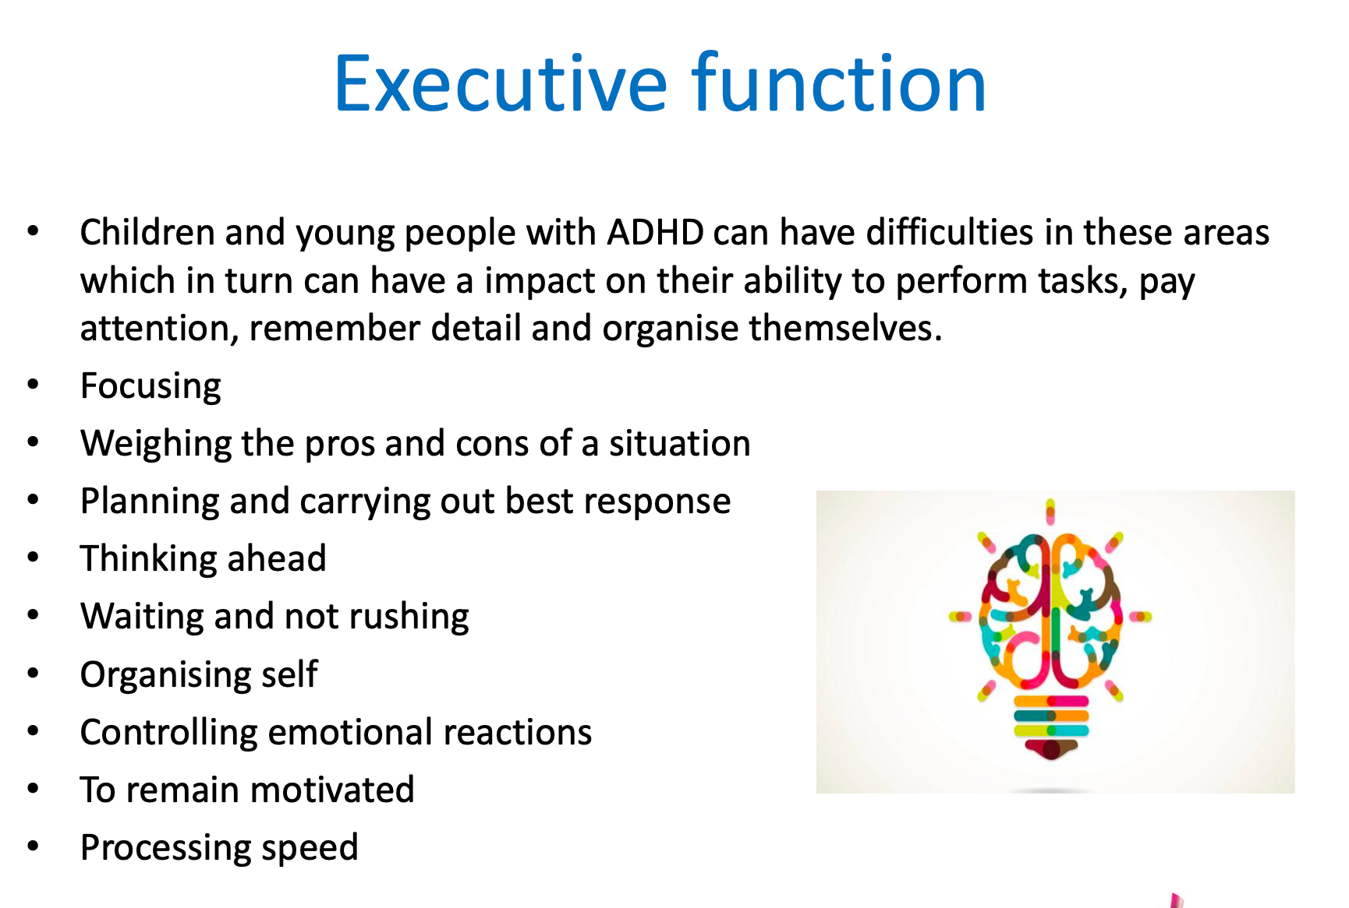

Slide 10
Resources
Find them on our school website!
Evening Routines
Sensor Circuits
Activities to relax
Emotion Coaching resources
ADHD children’s booklets

